Slide 1
Designing Learning Activities
Team 3 – Frank, Robert, Jeff & Stephen

Slide 2
Agenda
Warmup/Brain Teaser – Frank
Introduction – Jeff
Description of Learning Activities – Rob/Stephen
Group Learning Activity
Summary
Question Period
Reflection

Slide 3
Warm up
https://www.hangmanwords.com/play/custom-R2FtaWZpY2F0aW9u

Slide 4
Introduction
What is a learning activity?
Why are learning activities important to use?
What are common types of learning activities?

Slide 5
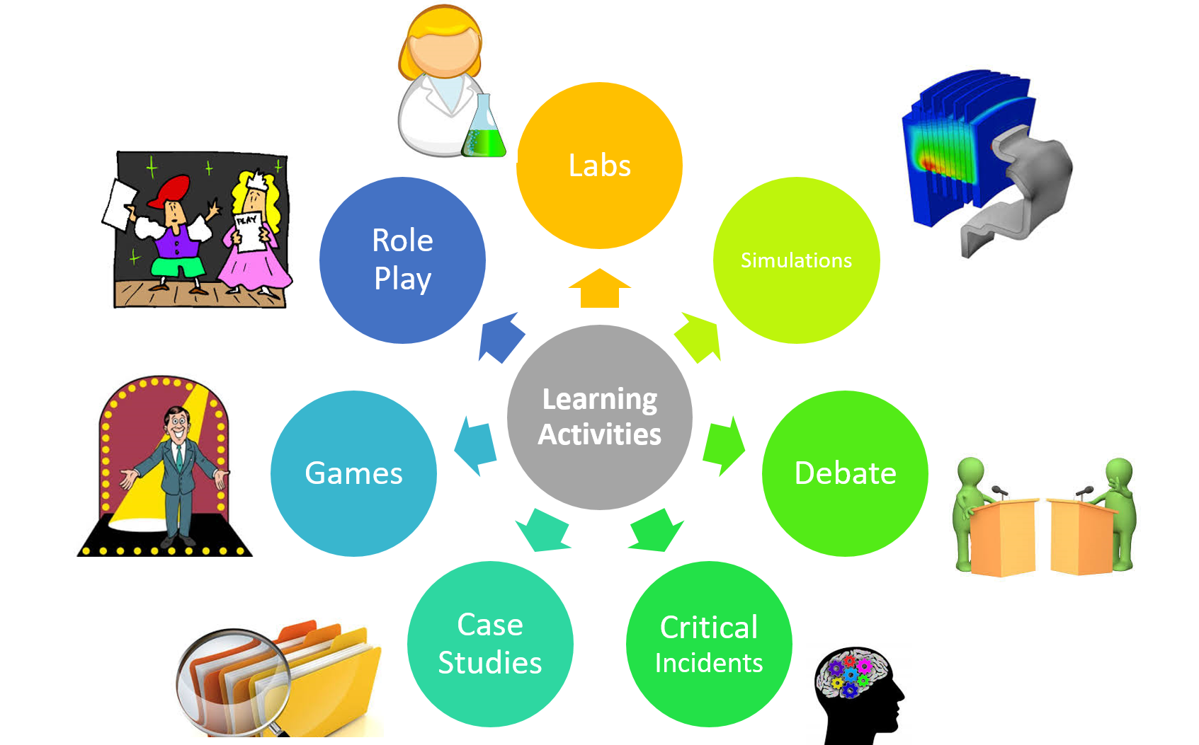
In class learning activities

Slide 6
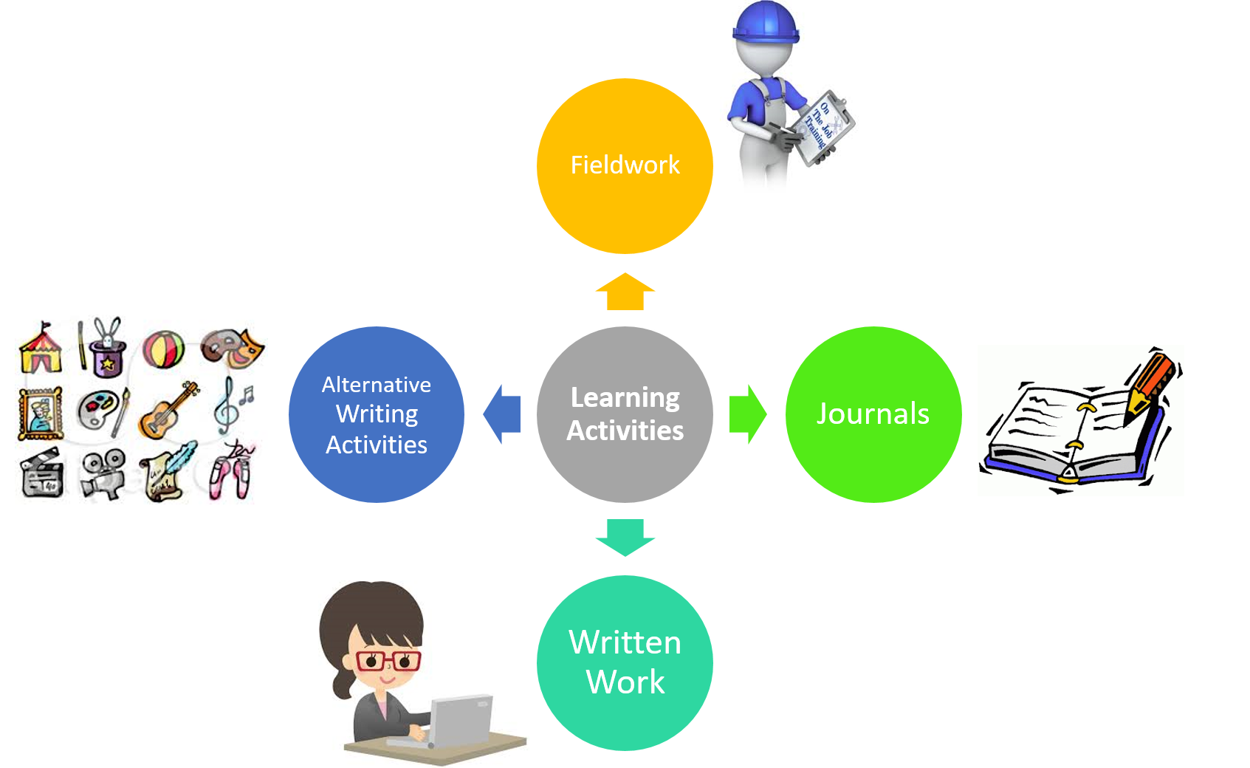
Outside of class learning activities

Slide 7

Role play
Use a real life or fictional scenario
Participants are given certain roles to play in a conversation or other interaction
Participants may be given instructions on what to say, or how to act, or simply just act it out as they normally would

Slide 8

Debates
Formalized discussions in which teams of people argue for or against a particular point of view
Encourage alternate ways of thinking by having participants argue for a position opposite to the one they hold

Slide 9

Case study
Based on a real life problem or event
Should be challenging, thought provoking and have no obvious answer – meant to be subjective
Ends with a question or questions about what to do next

Slide 10

Critical incidents
Students think back to recall an incident or incidents, positive or negative
Who was involved? Where did it happen? What insights did you gain?

Slide 11

Simulation
Facilitating a realistic work scenario in a safe environment
Encourages discussion to examine the reasoning for the choices made

Slide 12

Games
Help learners apply what they have learned with an element of competition

Slide 13

Labs
Students learn to do something
More realistic than a simulation
In a controlled environment vs actual field condition

Slide 14




Outside of Classroom
Fieldwork
On the job training (OJT)
Written work
Essays or papers
Journals
Documenting observations related to work being done
Alternative writing and creative activities
Poetry, interviews, painting, music, film, drama, etc.

Slide 15
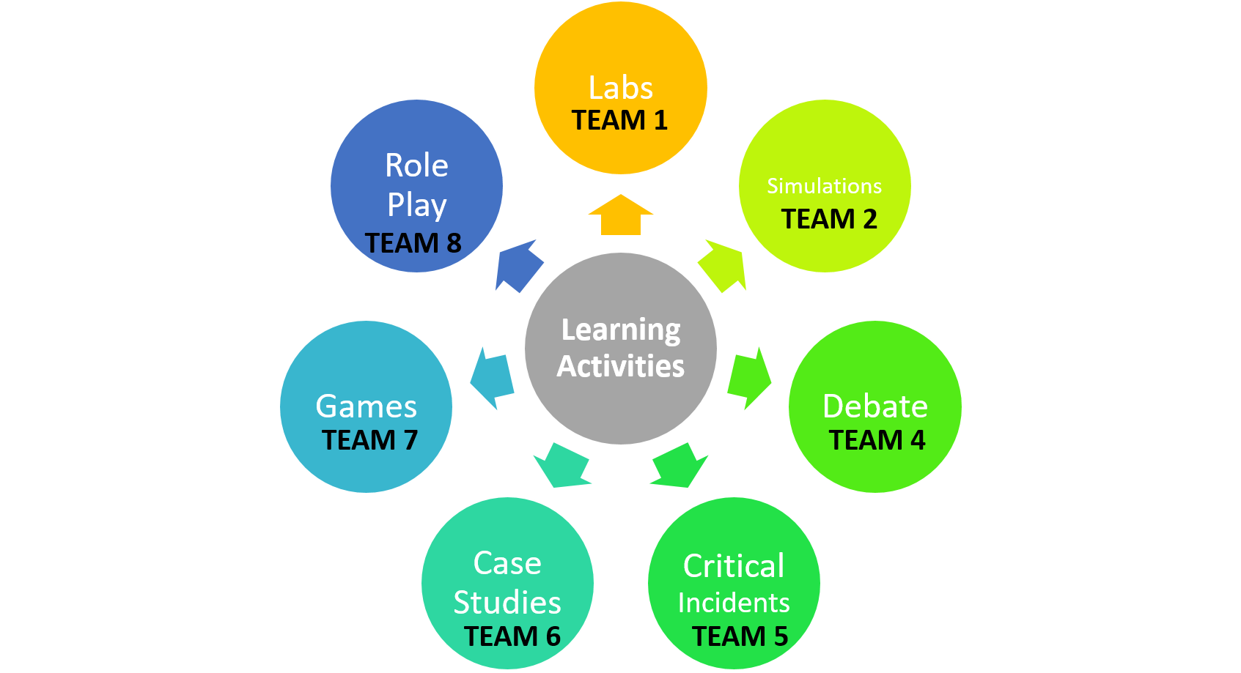
Learning Activity – Critical Incident
Think back on a classroom situation where one of these learning activities have been used. This could be a situation you have either led as an instructor or participated in as a student:
What made this learning activity an effective tool?
Was this a learning activity that could be effectively used in your particular field of instruction?
What would you do differently if you were to use this technique in your classroom?

Slide 16
Summary
We provided a variety of strategies to incorporated learning activities into your classrooms.
They encourage discussion, reflection, and thinking in different ways.
It is important that activities have a well defined purpose and provide room for discussion.

Slide 17

Questions

Slide 18
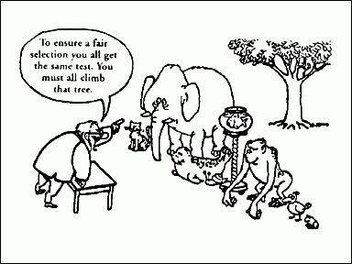
Reflection

